Slide 1
Service-oriented Software Engineering (SoSE)
Developing Asynchronous REST WS with Apache CXF-Maven and Asynch
Prof. Marco Autili
University of L’Aquila
marco.autili@univaq.it
http://people.disim.univaq.it/marco.autili/

Slide 2
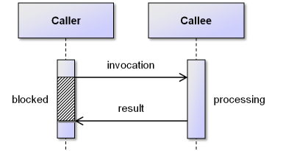
(client-side) synchronous and asynchronous invocation (from previous lectures)
Synchronous means that you call a web service (or function or whatever) and wait until it returns
All other code execution and user interaction is stopped until the call returns
Asynchronous means that you do not halt all other operations while waiting for the web service call to return
Other code executes and/or, e.g., the user can continue to interact with the page (or program UI)
According to the above descriptions, and by using a REST-oriented terminology, synchronous or asynchronous refer to the behavior of the client (and not the server) that is requesting a resource (or, if you want, a client that is invoking a resource method)

Slide 3
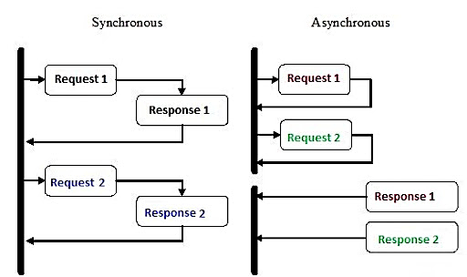
Possible request-response flows (from previous lectures)

Slide 4
Synchronous vs Asynchronous invocation of SOAP WS (from previous lecture)
(client-side) Synchronous invocation means that the client invokes a web service and waits for the response to return before it can continue with its work
In cases where the response takes a short time, this method of invoking the Web service is common
When an operation invocation is known to take a long time, asynchronous request-response feature of Web services can often be more appropriate
(client-side) Asynchronous invocation means that the client does not halt all other operations while waiting for the web service to return
Practically, rather than invoking the operation directly, the client invokes an “asynchronous flavor” of the same operation
As we saw, on the client side, this “asynchronous flavor” of the operation can be automatically generated from the WSDL

Slide 5
Ingredients
Java SE Development Kit 21
https://www.oracle.com/java/technologies/javase/jdk21-archive-downloads.html
Eclipse IDE for Enterprise Java Developers
https://www.eclipse.org/downloads/packages
Apache Tomcat® (v.11.0.4) [core - zip or tar.gz]
https://tomcat.apache.org/download-11.cgi
Apache CXFTM (v.4.1.1) [binary distribution - zip or tar.gz]
http://cxf.apache.org/download.html
Apache Maven (v.3.9.9)
https://maven.apache.org/download.cgi

Slide 6
Both client side and server side
We are now going to exploits asynchrony on both the client side and server side
Asynchronous invocation on the client side
Asynchronous request processing on the server side

Slide 7
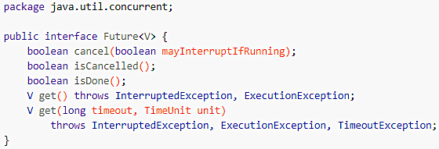
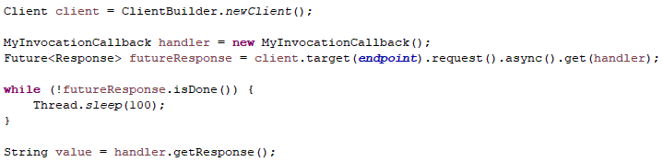

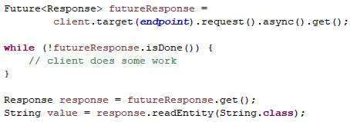

(client-side) Asynchronous invocation of a REST WS
As for SOAP WS, on the client side:
1) Polling approach - in this case, we take advantage of the Future Interface. The Future interface is defined within the java.util.concurrent package that comes with the JDK.
You can use a Response object
Future<jakarta.ws.rs.core.Response> or unmarshal to your own specific type Future<it.univaq.MyResponseType>
Client side
Client side
non-blocking Pattern
Blocking Pattern

Slide 8
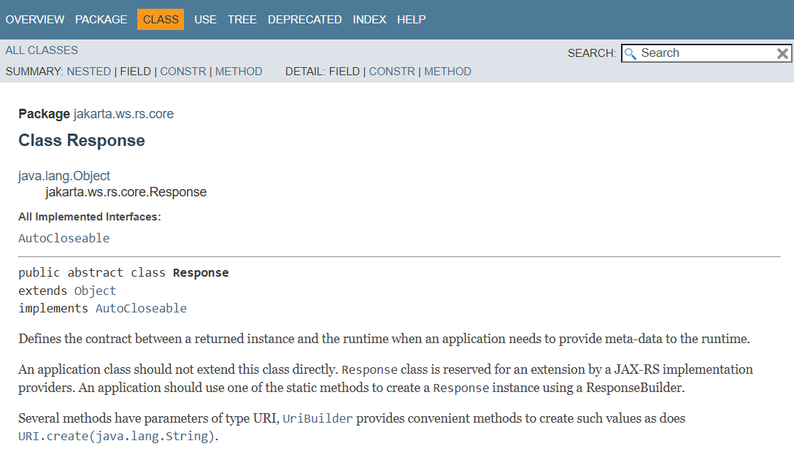
jakarta.ws.rs.core

Slide 9
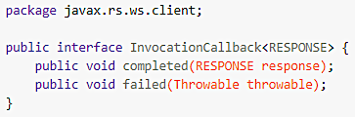
(client-side) Asynchronous invocation of a REST WS
2) Callback approach - JAX-RS introspects the application class that implements InvocationCallback to determine whether your callback wants a Response object or if you want to unmarshal to a specific type. Therefore, you must create a class that
implements InvocationCallback<jakarta.ws.rs.core.Response> or
implements InvocationCallback<it.univaq.MyResponseType>
implements
Client side

Slide 10
(server-side) Asynchronous request processing
Request processing on the server works by default in a synchronous processing mode, which means that a client connection of a request is processed in a single I/O container thread
This model is typically sufficient for processing of requests for which the processing resource method execution takes a relatively short time
When a resource method execution is known to take a long time to compute the result, a server-side asynchronous processing model should be used
In this model, the association between a request processing thread and client connection is broken
To implement it on the server side, we will use jakarta.ws.rs.core.AsyncResponse with the annotation @jakarta.ws.rs.core.Suspended

Slide 11
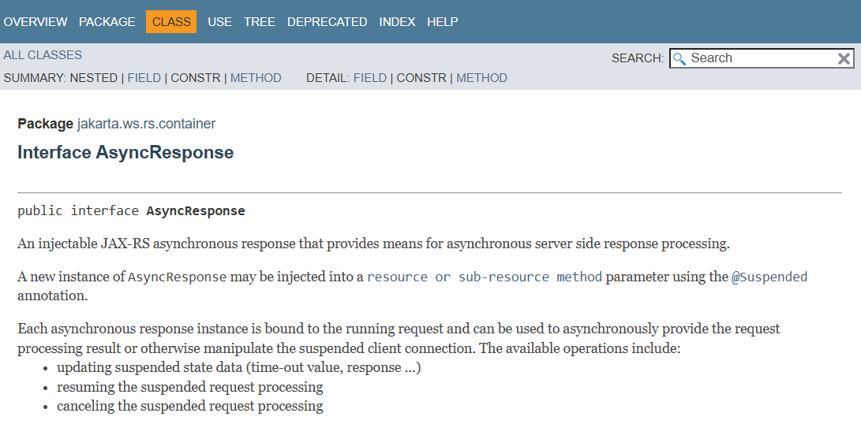
jakarta.ws.rs.container.AsyncResponse

Slide 12
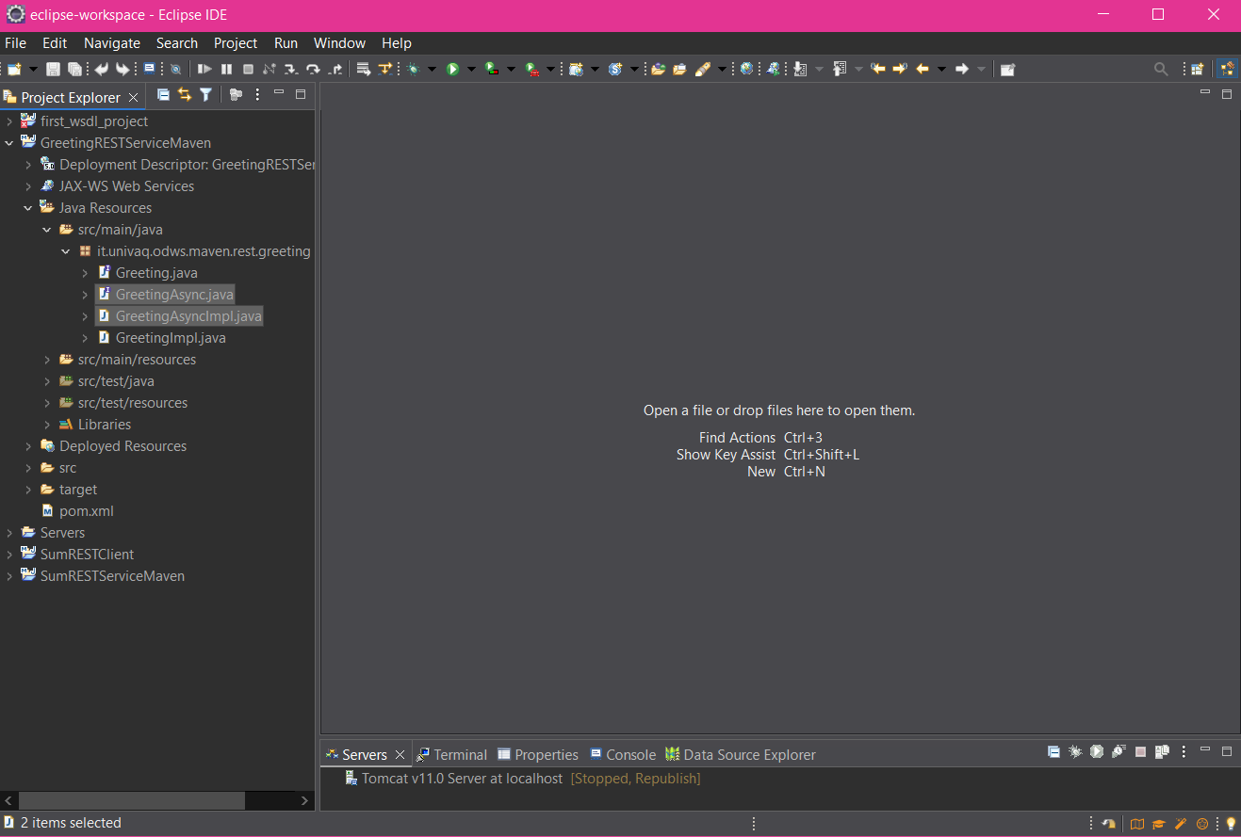
Create GreetingAsync and GreetingAsyncImpl
1
2

Slide 13
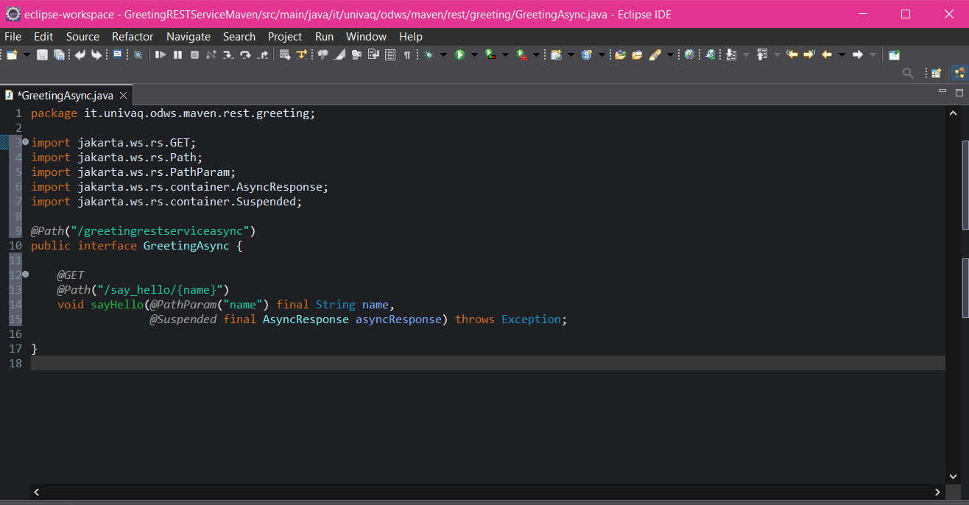
Define the GreetingAsync Interface
The @Suspended annotation enables server-side asynchronous request processing.
As it will be clearer later, it has nothing to do with the client-side asynchronous invocation...
1
2
3
4
The @Suspended annotation serves to get access to an AsyncResponse instance by injecting it into a JAX-RS method
In this way, the HTTP request becomes suspended from the current thread of execution

Slide 14
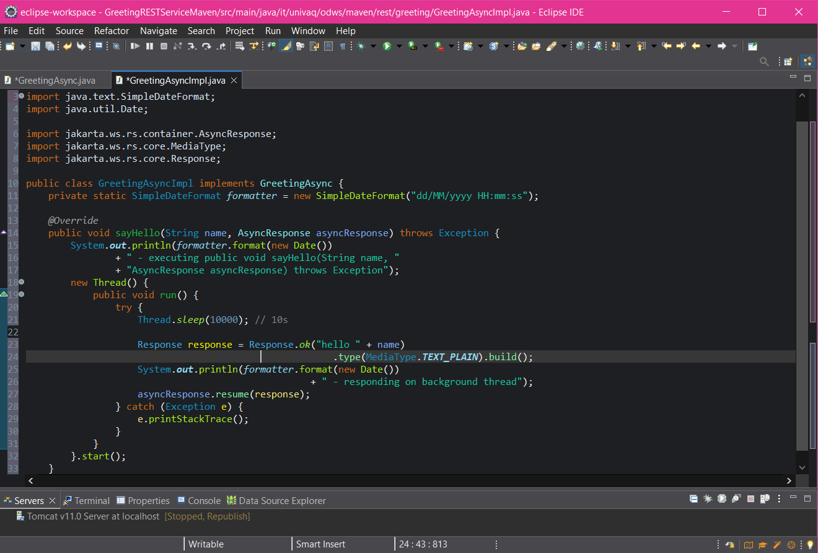
Define the GreetingAsyncImpl class
Invoking resume() in this manner means that it is a successful response. So, a status code of 200 is sent back to the client. By passing a Response object to the resume() a more specific response is sent back
1
2
3

Slide 15
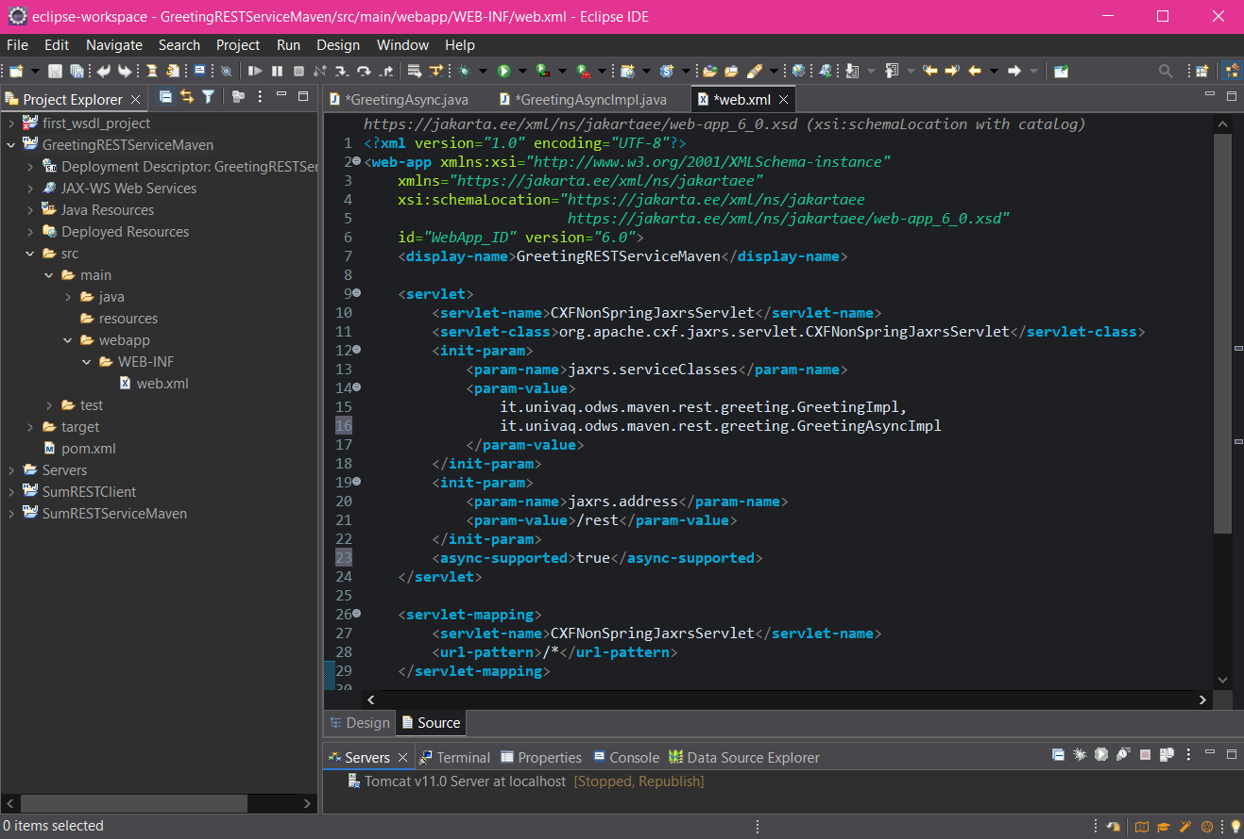
Register the new REST interface and support Async
1
Separate service classes using the comma
2

Slide 16
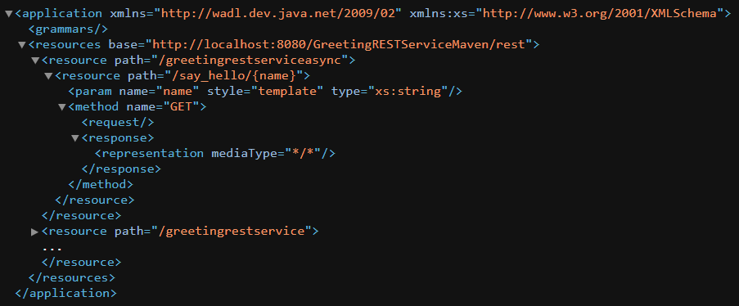
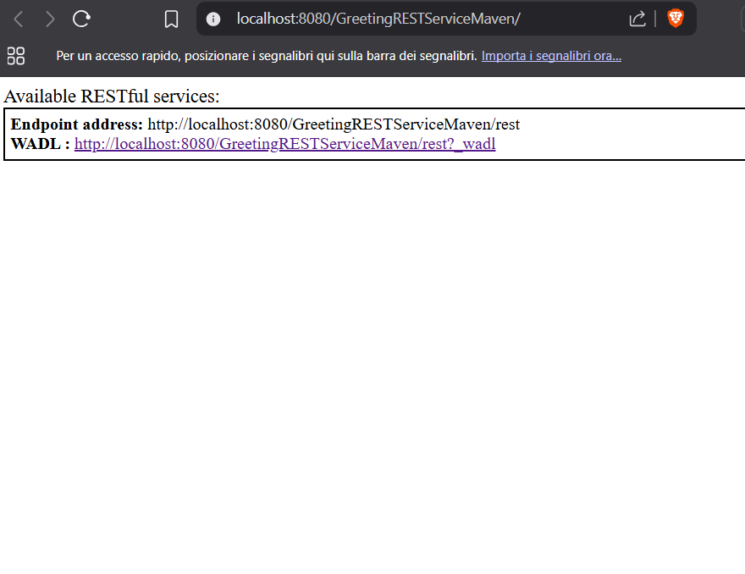
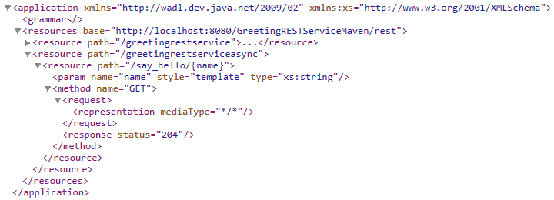
Deploy the Service
1
2
204 - No content: the request was successful but there is no data to transfer

Slide 17
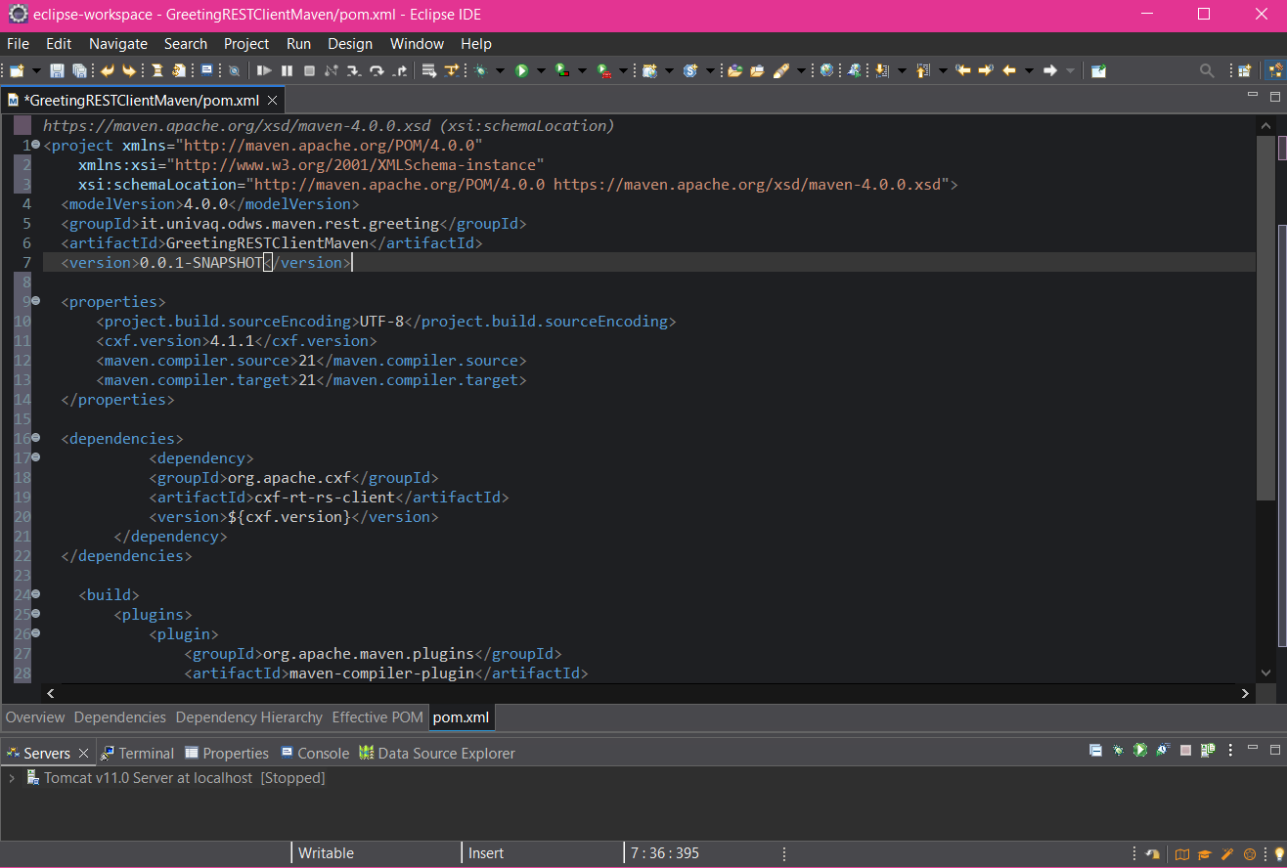
Create the GreetingRestClientMaven
1

Slide 18
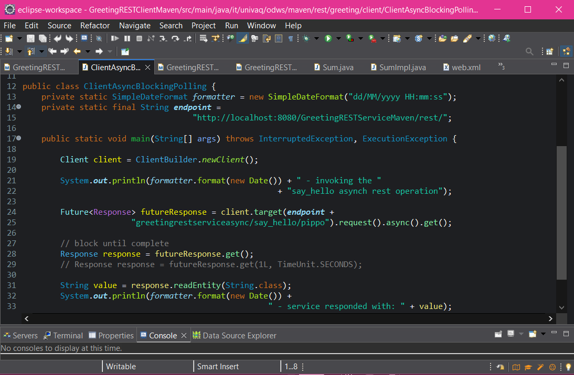
Create the ClientAsyncBlockingPolling
(Asynchronous invocation) The service returns the control immediately
(blocking method)
Blocked here until the response is available

Slide 19
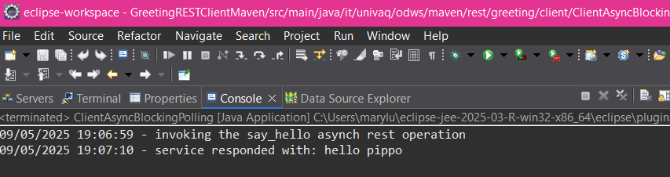
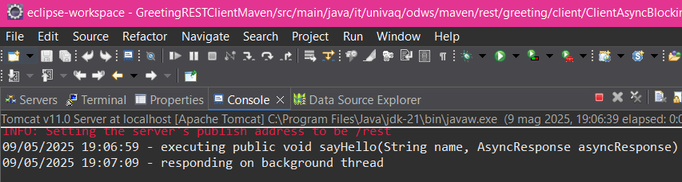
Execute the ClientAsyncBlockingPolling
1
client
2
service

Slide 20
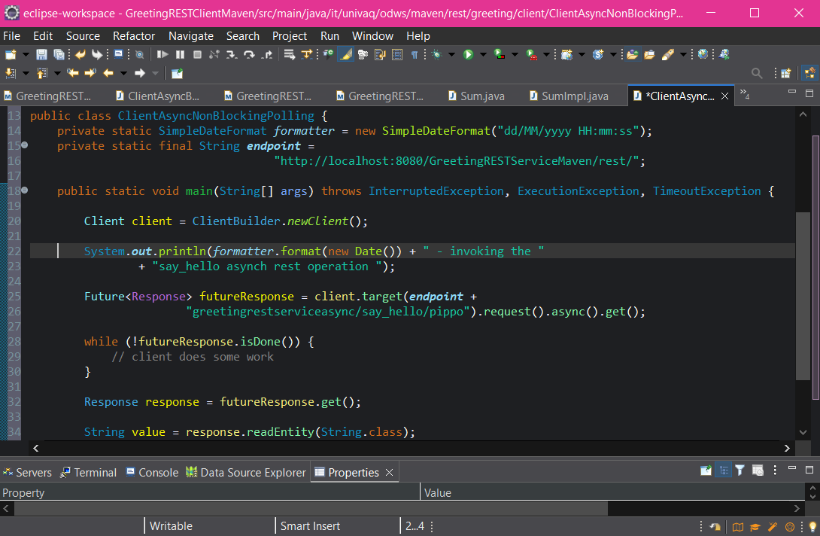
Create the ClientAsyncNonBlockingPolling
(Asynchronous invocation) The service returns the control immediately
non-blocking method
Try yourself: perform some job here, and printout something ...
not blocked here
the response is now available

Slide 21
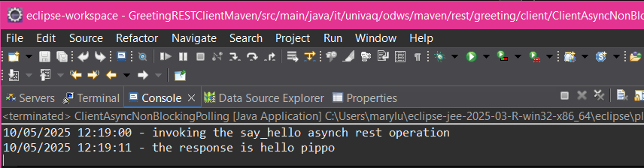
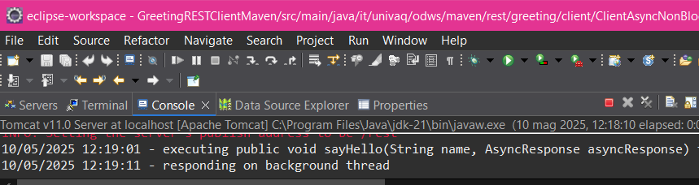
Execute the ClientAsyncNonBlockingPolling
1
client
2
service

Slide 22
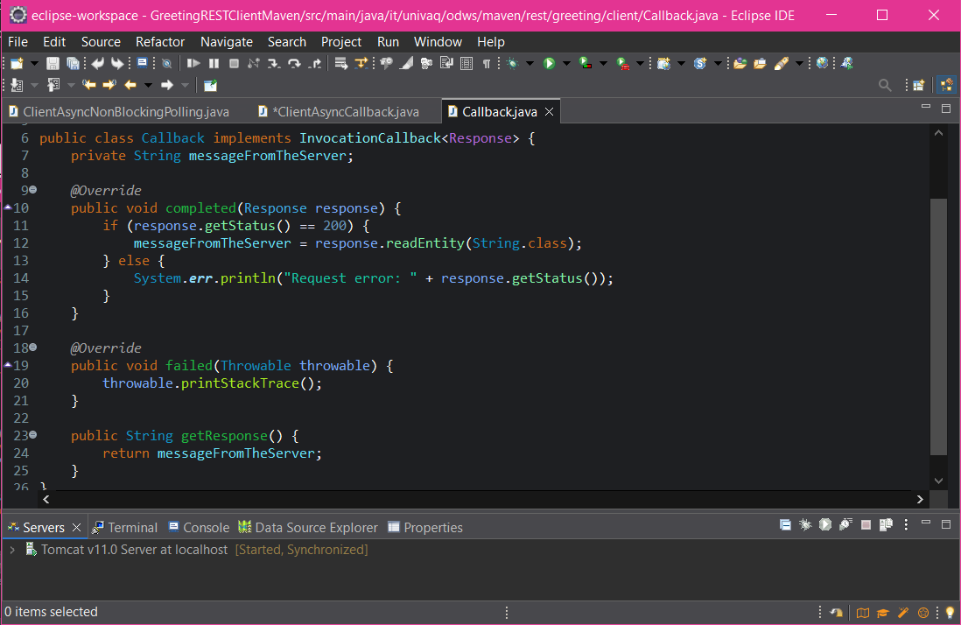
Create the Callback class
1
2

Slide 23
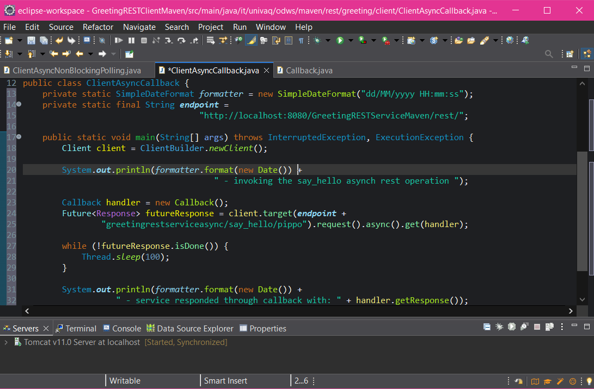
Create the ClientAsyncCallback
(Asynchronous invocation) The service returns the control immediately
Again, instead of sleeping, try to perform some job here, and printout something ...
get the response data from the callback object
non-blocking method

Slide 24
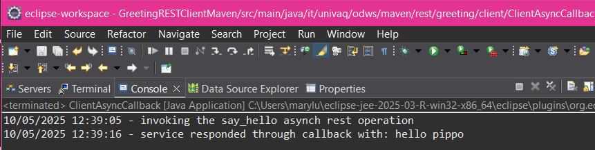
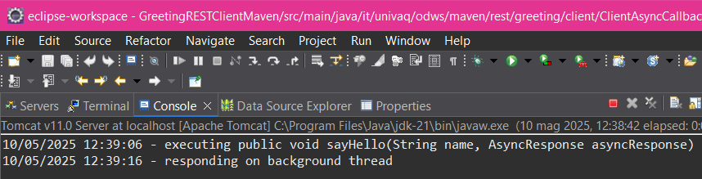
Execute the ClientAsyncCallback
client
1
service
2

Slide 25
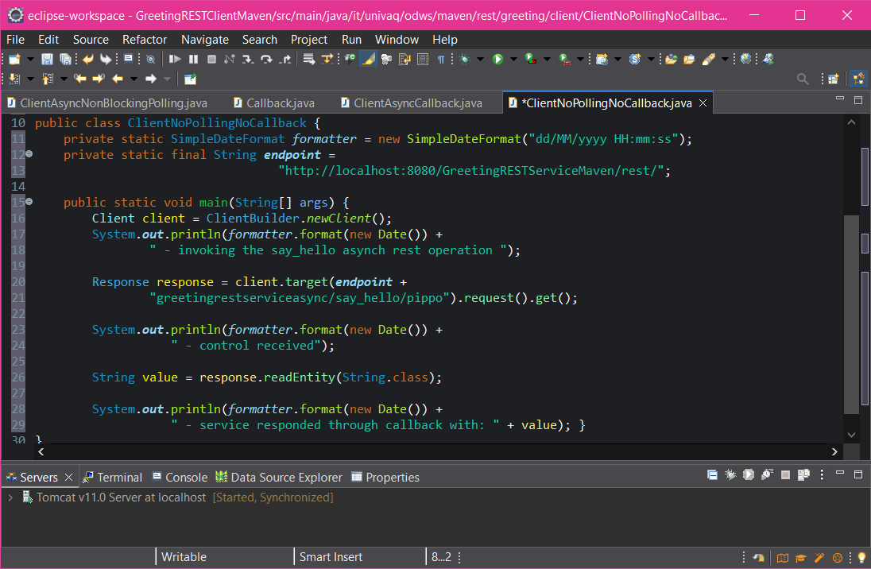
Create the ClientNoPollingNoCallback
syncronous call

Slide 26
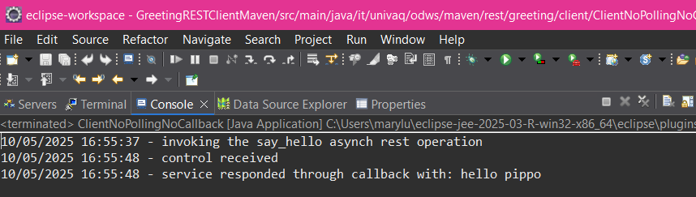
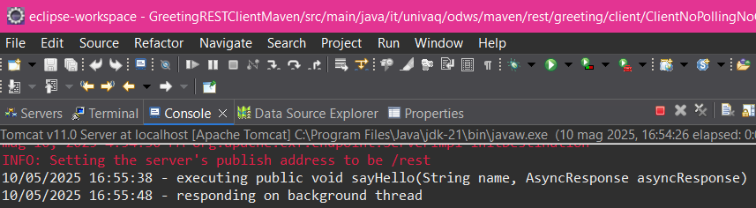
Execute the ClientNoPollingNoCallback
1
client
service
2

Slide 27
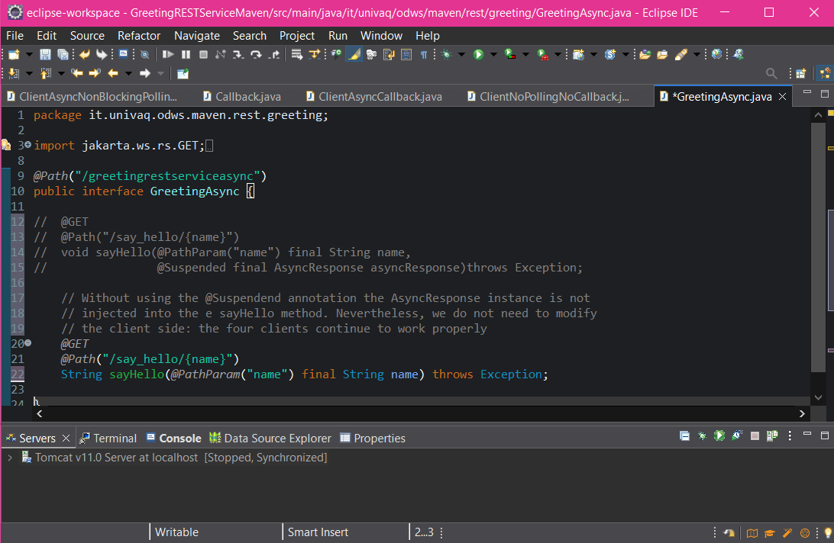
Without using @Suspended

Slide 28
Summing up
Future VS Callback
What do you think about the following statements? Do you agree?
Use Future if you need to join a set of requests you’ve invoked asynchronously. By join, I mean you need to know when each of the requests has finished, and you need to perform another task after all the asynchronous requests are complete
e.g., maybe you are gathering information from a bunch of different web services to build a larger aggregated document (a mashup)
Use Callback when each invocation is its own distinct unit and you do not have to do any coordination or mashing up
Anyway, it is not easy to generalize... search the web yourself ☺

Slide 29
https://www.baeldung.com/java-callbacks-listenablefuture-completablefuture

Slide 30
References
https://javaee.github.io/tutorial/jaxrs002.html
https://jakartaee.github.io/rest/apidocs/3.0.0/jakarta/ws/rs/core/MediaType.html
https://docs.oracle.com/cd/E19798-01/821-1841/gipzh/index.html
http://cxf.apache.org/docs/jax-rs-client-api.html
https://allegro.tech/2014/10/async-rest.html

